Slide 1
Lending Club Data Default Analysis
Chandan G Gowdar

Slide 2
Objective
The Objective of this case study is to implement EDA technique on a real world problem and understand the insights and present in a business first manner via presentation.
Benefits of the case study:
Gives a idea about how EDA is used in real life business problems.
It also develops a basic understanding of risk analytics in banking and financial services.
How the data is used to minimize loss of money while lending it to clients.
It improves our understating of visualization and what charts to use for real life data.

Slide 3
Business Understanding
The business objective is to take a decision whenever they receive a loan application whether to reject or approve based on certain variables.
Dataset Details:
The data given below contains information about past loan applicants and whether they ‘defaulted’ or not. Data has details regarding approved loan not the rejected ones. It has 3 status of loan which is Fully Paid, Current and Charged-Off.
Data Clean-up and preparation process:
Importing the Data
Removing large null value columns
Removing irrelevant columns
Removing/Fixing null values
Correcting data types and deriving new columns
Filter Data for requirement.
Removing Duplicate Data
Removing outliers

Slide 4
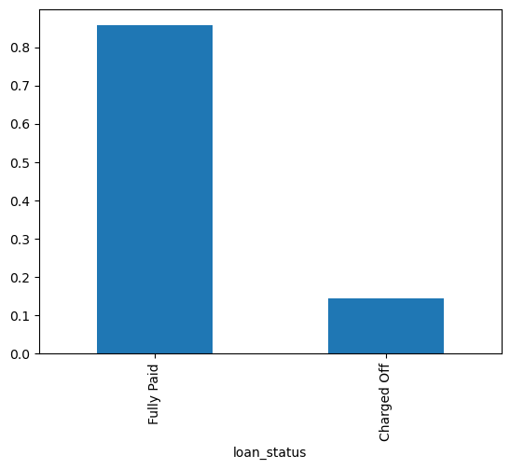
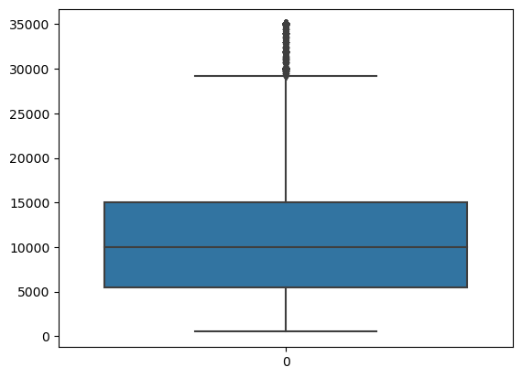
Loan Status and Amount
Loan Status: Charged off less in number than fully paid borrowers
Loan Amount: Max amount of loan is from 5000 – 15000.

Slide 5
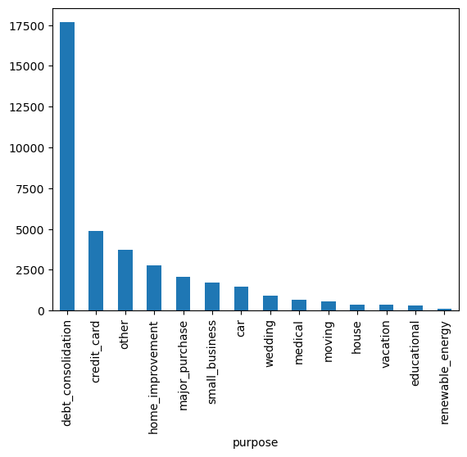
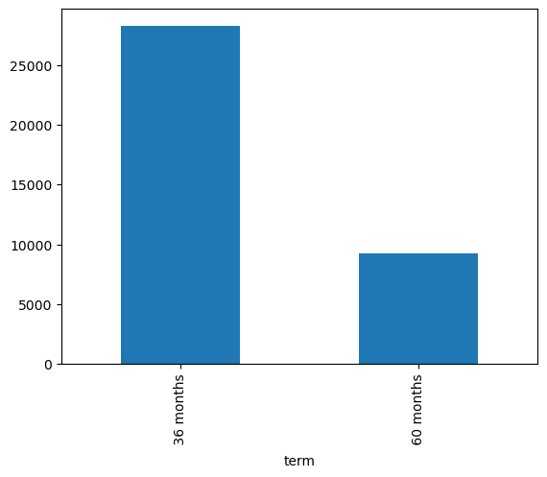
Term and loans types
Loan Term: Almost 75%(28287) of the borrowers take loan of 36 month
Loan types: There are so many reasons for a take a loan from that purposes of taking loan is debt_consolidation i.e 47%
.

Slide 6
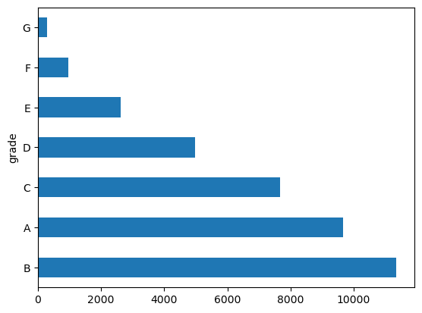
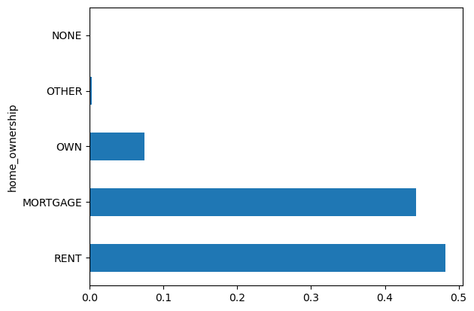
Grade and Home ownership
Grade: There are A to G grades according to the performances of the people from that the highest people have a grade B
Sub Grade: There is almost same amount of the people who livw in rent room or mortagage

Slide 7
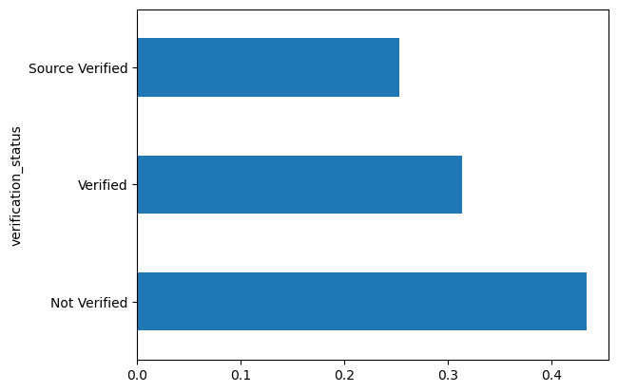
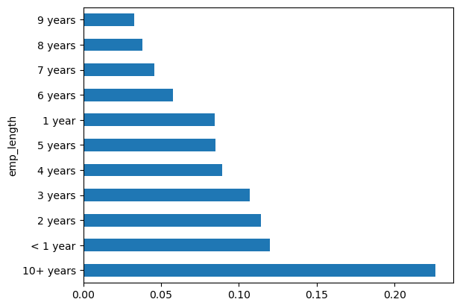
Verification status & employment length
Verification status: Not verified borrowers are
greater than the verified
Employment length : majority of borrowers of work experience greater than 10 years

Slide 8
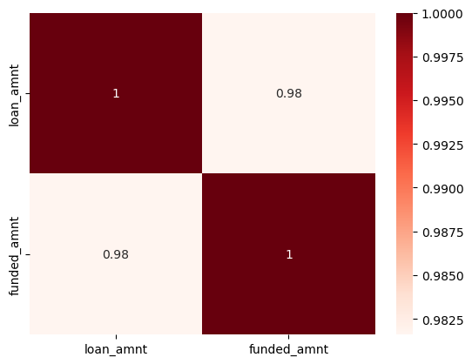
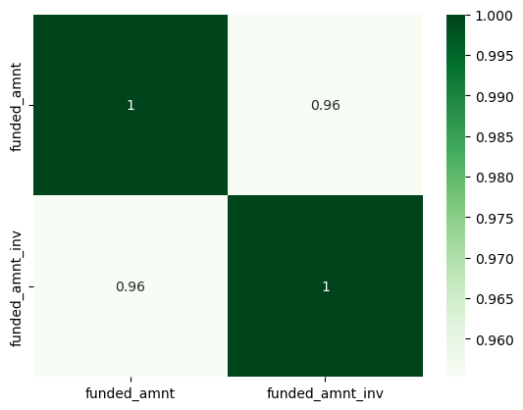
Correlation: loan amount vs funded amount :
Strong positive correlation : correlation coefficient is 0.98 . Loan amount increases the funded amount also increase.
.Correlation : funded amount vs funded amount interest:
Strong positive correlation: correlation coefficient is 0.96 .

Slide 9
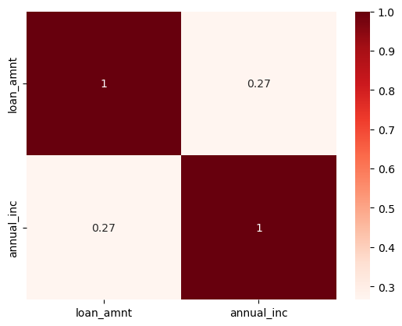
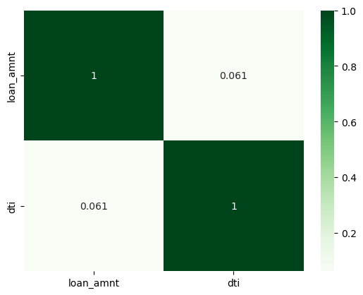
Correlation : loan amount vs annual income: and loan amount vs dti
1) Weak positive correlation. The correlation coefficient is 0.27 . Slight tendency for individuals with highest annual incomes to also have larger loan amounts
2) weak positive correlation . The correlation coefficient is 0.061.

Slide 10
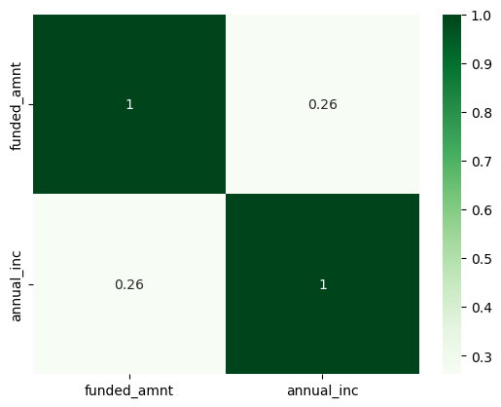
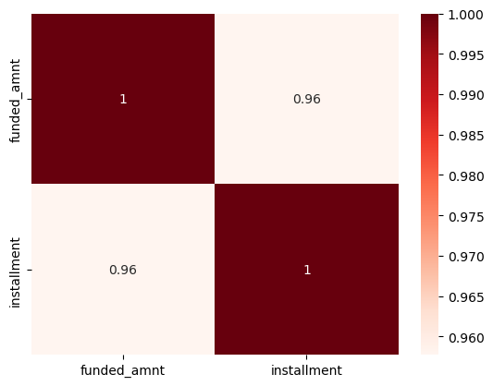
.
Correlation : annual income vs funded amount and funded amount vs insatllment
1) Weak positive correlation . i.e 0,26 . Annual income increases. Funded amount tends to increases slightly .
2) strong positive correlation i.e 0.96. funded amount increases installment also increases and vice versa

Slide 11
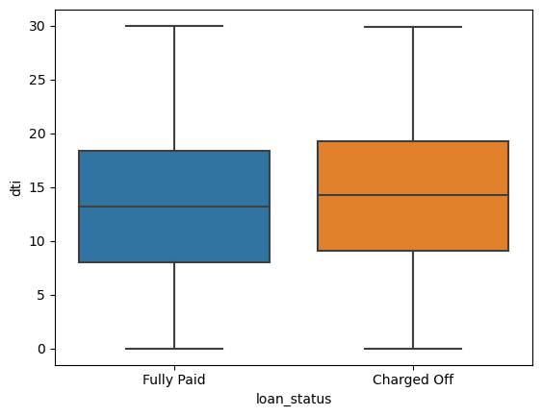
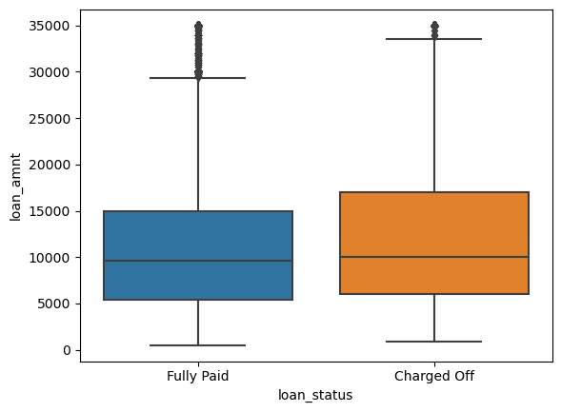
loan status vs dti and loan status vs loan amount
1) dti and loan status have almost same median
2) higher loan amount being likely to be fully paid

Slide 12
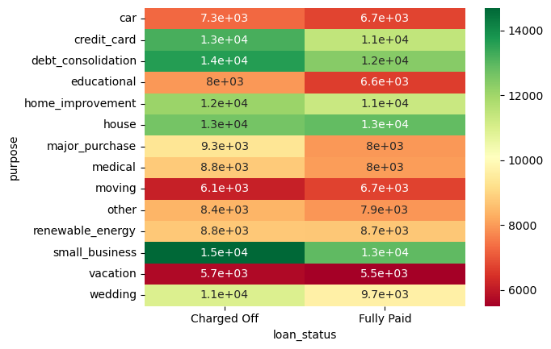
loan status vs purposes vs loan_amnt
1)Highest average loan amounts: Charged Off: Small business loans (14,686) Fully Paid: House loans (12,881)
2)Lowest average loan amounts: Charged Off: Vacation loans (5,707) Fully Paid: Vacation loans (5,510)
3)Purposes with noticeably higher charged-off amounts than paid amounts: Small business loans (difference of 1,776) Credit card loans (difference of 1,738) Major purchase loans (difference of 1,388)
4)Purposes with relatively similar charged-off and paid amounts: Renewable energy loans (difference of 178) Moving loans (charged-off amounts are even slightly lower)

Slide 13
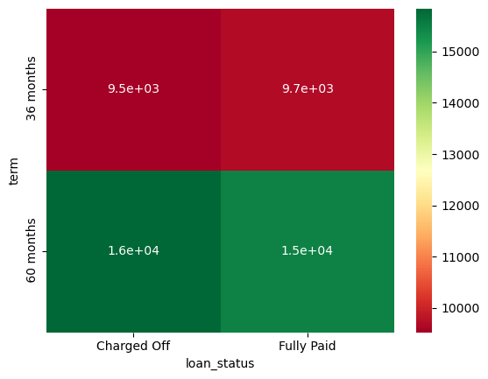
loan status vs term vs loan amount
There is almost same amount of loan charged off and full paid borrwers in 36 months and 60 months

Slide 14
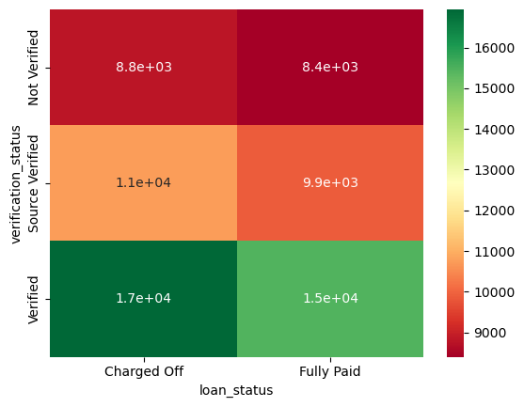
loan status vs loan_amnt vs verification status
no such big difference occur in that but borrowers which charged off mostly are verified and have the loan amount greater than 16000

Slide 15
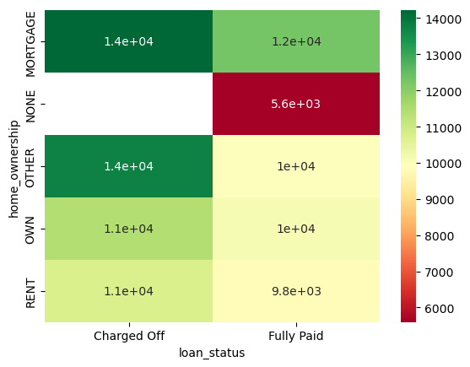
loan status vs loan_amnt vs home ownership
Borrowers which charged off mostly are from mortagage and other

Slide 16
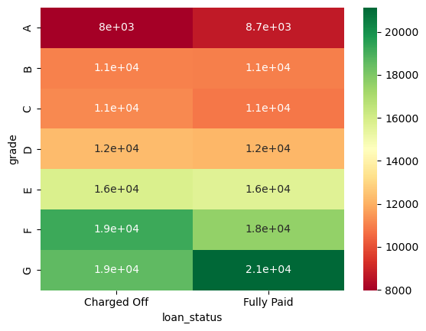
loan status vs loan amount vs grade
Higher loan amounts are generally associated with higher risk grades (E, F, G) and charged-off statuses.
Loan amounts tend to be more similar between fully paid and charged-off loans for lower risk grades (A, B, C).
The distribution of loan amounts for fully paid loans is relatively consistent across grades.
Charged-off loans show more variability in loan amounts, especially for higher risk grades.

Slide 17
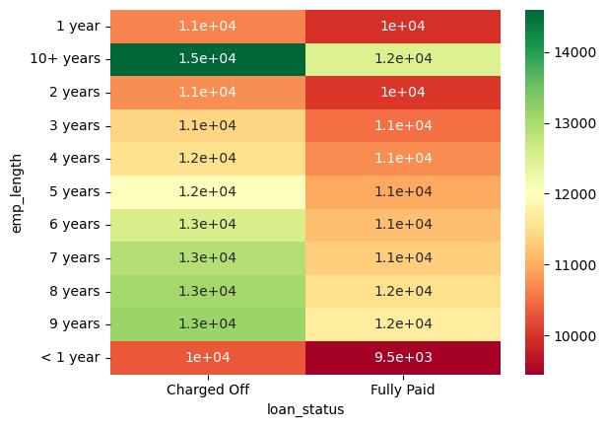
loan_amnt vs loan status vs dti
Charged Off Loans Concentrated in Shorter Employment Lengths: The highest loan amounts for "Charged Off" loans are concentrated in the first few years of employment ("1 year," "2 years," and "4 years"). This suggests a potential correlation between shorter employment lengths and higher risk of loan defaults.
Fully Paid Loans More Evenly Distributed: The loan amounts for "Fully Paid" loans are more evenly distributed across different employment lengths, with no clear pattern of higher or lower amounts in specific ranges.¶

Slide 18
Recommendation
Recommendations to Identify Risk Factors for Loan Defaulters:
Based on the provided univariate, segmented univariate, bivariate, and multivariate analyses, here are some recommendations to identify risk factors for loan defaulters:
1. Focus on borrowers with:
Higher loan amounts:
The analysis shows a positive correlation between loan amount and default. Loans exceeding ₹16,000, especially for charged-off loans, might be risky.
Lower income levels:
Charged-off borrowers tend to have lower median annual income compared to fully paid ones. Analyze income levels in relation to loan amounts to identify potential risks.

Slide 19
Recommendation
Shorter employment lengths:
Charged-off loans are concentrated in borrowers with shorter employment histories (1-4 years). Consider employment stability as a risk factor.
Higher debt-to-income ratios (dti):
While the correlation is weak, a higher dti might indicate higher financial burden and potential for default. Monitor dti in conjunction with other factors.
Risk grade E, F, or G:¶
These grades are associated with higher loan amounts and charged-off statuses. Analyze loan grade distribution for borrowers with higher risk profiles.

